Slide 1
Towards Trustworthy Large Language Models
Wenyue Hua
Rutgers University, New Brunswick
Advisor: Yongfeng Zhang
Defense committee: Hao Wang, He Zhu, Yongfeng Zhang, Yu Su
August 26, 2024

Slide 2
Background: Large Language Models
Interpretability
Lack of interpretability for model behavior
An automatic error detection tool with linguistic explanation benchmark
Fairness
LLM-based recommender system
An efficient user-controllable fairness framework
Safety
LLM-based agent
A three-stage safety strategy
Data Contamination in Evaluation
Dynamic Benchmaking
Difficult to be hacked
Conclusion
Q&A
Agenda

Slide 3
Background: Large Language Models
Interpretability
Lack of interpretability for model behavior
An automatic error detection tool with linguistic explanation benchmark
Fairness
LLM-based recommender system
An efficient user-controllable fairness framework
Safety
LLM-based agent
A three-stage safety strategy
Data Contamination in Evaluation
Dynamic Benchmaking
Difficult to be hacked
Conclusion
Q&A
Agenda

Slide 4
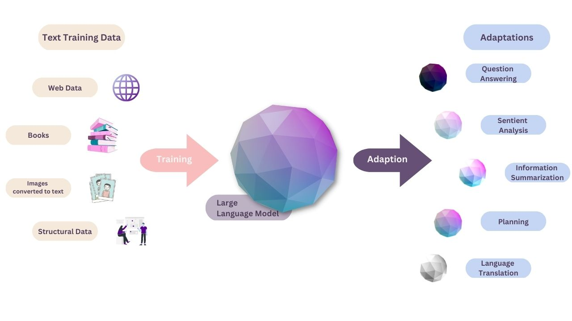
Background: LLMs
Image from https://renaissancerachel.com/large-language-models-overview/

Slide 5
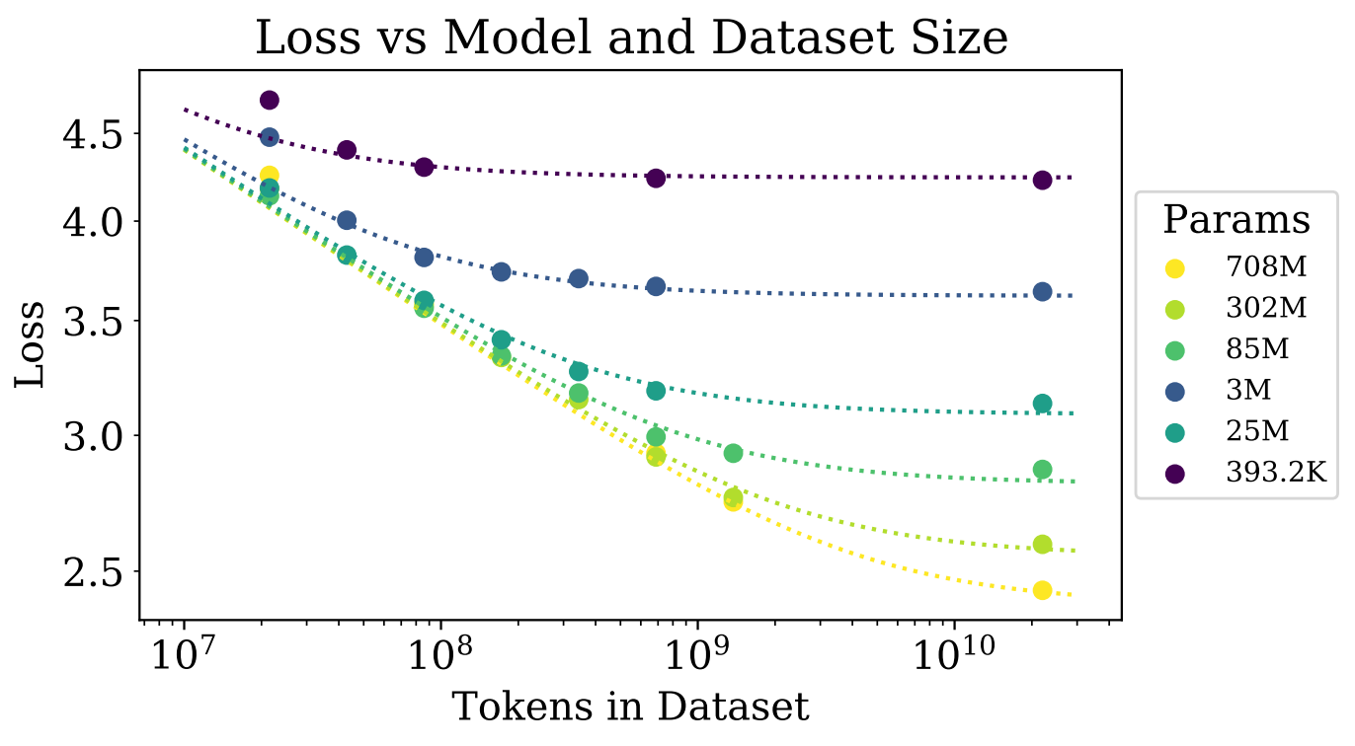
Background: LLMs
Scaling law for LLM
Models with more FLOPs (~model parameters)
Models trained on more data
Models trained on better quality data
Scaling-law-fueled LLM
Stronger text understanding ability
Stronger reasoning ability
Image from https://towardsdatascience.com/language-model-scaling-laws-and-gpt-3-5cdc034e67bb

Slide 6
Background: Trustworthy LLMs
Noticed Problems:
Limited Interpretability [Madsen et al, 2022]: interpretability is defined as the ability to explain or to present its behavior in understandable terms to a human, while LLMs are poor on this.
Biases and Fairness [Nadeem et al, 2021]: LLM can amplify biases and discriminations that already exist in text.
3. Safety [Tian et al, 2023]: LLMs may generate harmful responses and are prone to be attacked and misused
4. Data contamination in evaluation benchmarks [Schaeffer, 2023; Zhu et al, 2024]: Various studies have shown the possibility that current LLMs could have been trained on test set, boasting their performance on various benchmark and mislead the users
…

Slide 7









My work on Trustworthy AI
W Hua, L Jin, L Song, H Mi, Y Zhang, D Yu. Discover, Explain, Improve: An Automatic Slice Detection Benchmark for Natural Language Processing
W Hua, Y Ge, S Xu, J Ji, Y Zhang. UP5: Unbiased Foundation Model for Fairness-aware Recommendation
Z Li, W Hua, H Wang, H Zhu, Y Zhang. Formal-LLM: Integrating Formal Language and Natural Language for Control
G Lin, W Hua, Y Zhang. PromptCrypt: Prompt Encryption for Secure Communication with Large Language Model
Trustworthy AI
W Hua, X Yang, Z Li, C Wei, Y Zhang. TrustAgent: Towards Safe and Trustworthy LLM-based Agents through Agent Constitution
W Hua, S Xu, Y Ge, Y Zhang. How to Index Item IDs for Recommendation Foundation Models
Hallucination
L Fan, W Hua, L Li, H Wang, Y Zhang. Dynamic Benchmark on Reasoning Ability of Large Language Models via Complexity Classes
Data
Contamination
Notes:
agents could be developed to prioritize human values, safety, and privacy, ensuring that their actions align with the best interests of individuals and communities

Slide 8
Background: Large Language Models
Interpretability
Lack of interpretability for model behavior
An automatic error detection tool with linguistic explanation benchmark
Fairness
LLM-based recommender system
An efficient user-controllable fairness framework
Safety
LLM-based agent
A three-stage safety strategy
Data Contamination in Evaluation
Dynamic Benchmaking
Difficult to be hacked
Conclusion
Q&A
Agenda

Slide 9
Discover, Explain, Improve:
An Automatic Slice Detection Framework for
Natural Language Processing
Wenyue Hua, Lifeng Jin, Linfeng Song, Haitao Mi, Yongfeng Zhang, Dong Yu
Rutgers University
Tencent America AI Lab
(Accepted to TACL)

Slide 10
Model Interpretability
Goal: facilitate model interpretability by automatically analyzing
the types of data points on which the model is likely to make errors
the underlying reasons for those errors

Slide 11
Model Interpretability by detecting error patterns
Language models often make systematic errors on coherent datapoints [Kayser-Bril, 2020; Stuart-Ulin, 2018; Ye et al, 2024].
Grammaticality Judgment Task
Sentence | Prediction | Label
It is Kim on whom that Sandy relies. | T | T
It is Kim on whom Sandy relies on. | T | F
It is Kim whom Sandy relies. | T | F
It is on Kim on whom Sandy relies. | T | F
Sentence | Prediction | Label
That's the most kind answer that I ever heard. | T | F
That's a most kind answer that I ever heard. | T | F
That's a kindest answer that I ever heard. | T | F
That's the kindest answer that I ever heard. | T | T
Wrong usage of preposition in “rely on”
Wrong usage of superlative

Slide 12
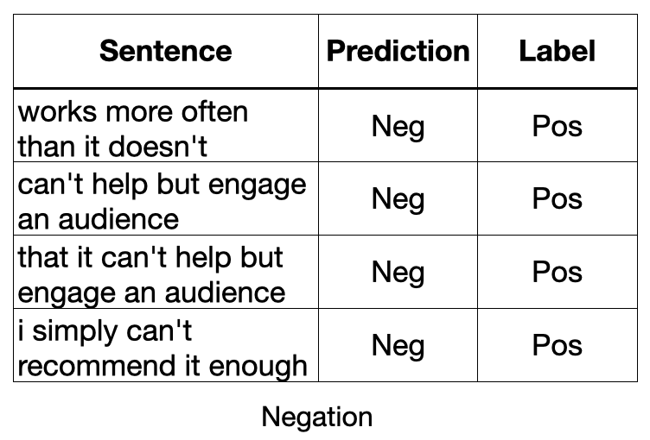
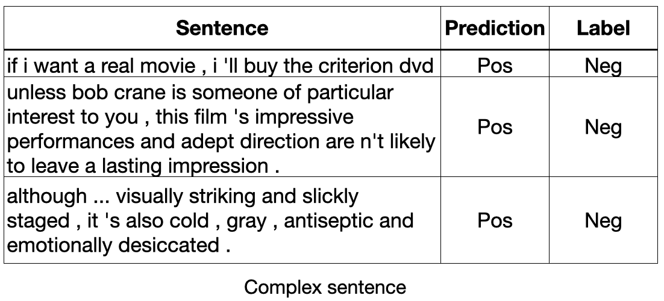
Model Interpretability by detecting error patterns
Language models often make systematic errors on coherent datapoints [Kayser-Bril, 2020; Stuart-Ulin, 2018; Ye et al, 2024].
Sentiment Analysis
Slice: a coherent group of datapoints that share a common characteristic [Eyuboglu et al. 2022].
Error Slice: a slice with low accuracy.

Slide 13
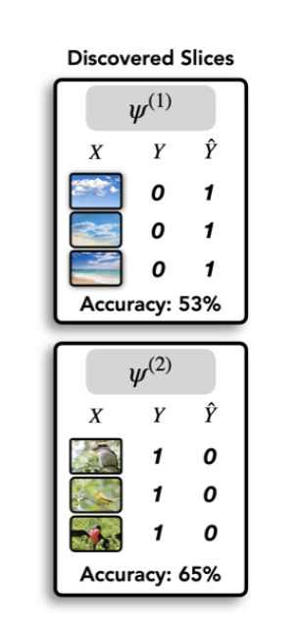
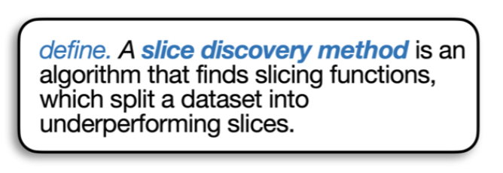
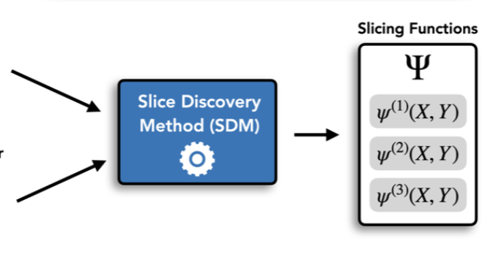
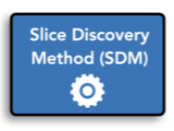
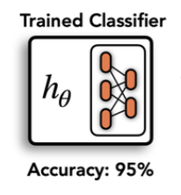
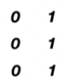
Can we automatically find systematic errors?
 | Sentence | Pred | Label
1 | It is Kim on whom that Sandy relies on. | T | F
2 | That's the most kind answer that I ever heard. | T | F
3 | It is Kim whom Sandy relies. | T | F
4 | It is on Kim on whom Sandy relies. | T | F
5 | That's a most kind answer that I ever heard. | T | F
6 | That's the kindest answer that I ever heard. | T | F
 | ……
different slices.
x1
x3
x4
x2
x5
x6
Figure 7: Overview of slice discovery model

Slide 14
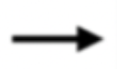
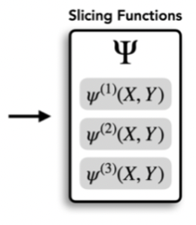
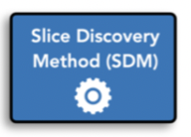

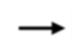
How to find error-prone datapoints given an SDM?
Sentence | Pred | Label
Tagalog is speak in the Philippines. | T | F
Tagalog is speaks in the Philippines. | T | F
Tagalog is spoke in the Philippines. | T | F
Unlabeled dataset
Sentence | Pred
French is spoken in France. | T
English is speak in the British. | T
They can sing. | T
Usually, any lion is majestic. | F
Many evidence was provided. | F
Chinese is speak by the largest population in world. | T
I wrote Blair a letter, but I tore it up before I sent it. | T
… | …
SDM
One example error slice
……
……

Slide 15
How to find error-prone datapoints given an SDM?
Sentence | Pred | Label
Tagalog is speak in the Philippines. | T | F
Tagalog is speaks in the Philippines. | T | F
Tagalog is spoke in the Philippines. | T | F
Unlabeled dataset
Sentence | Pred
French is spoken in France. | T
English is speak in the British. | T
They can sing. | T
Usually, any lion is majestic. | F
Many evidence was provided. | F
Chinese is speak by the largest population in world. | T
I wrote Blair a letter, but I tore it up before I sent it. | T
… | …
SDM
One example error slice
……
……

Slide 16
Goals of Project
Discover: Detect error-prone datapoints
given unlabeled new datasets, predicting which datapoints are error-prone
Train on
labeled
dataset
Slice Discovery
Model (SDM)
Explain: Find error-correlating features
given a slice, find what features are shared in common by the datapoints
Improve: Guide further model training
Knowing where the current model fails, we can improve model performance

Slide 17
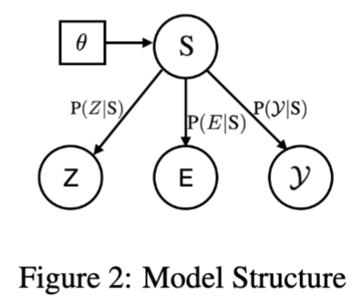
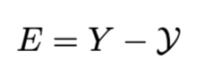
SDM Model: Edisa
[0.9, -0.9]
error
distance
[0.1, 0.9]
[1, 0]
Embedding
confidence
score
label
Embedding
Error
distance
confidence
score
Tuned model
Error-distance-aware multivariate Gaussian mixture model
(Edisa)
Figure 8: Edisa model structure
It is Kim on whom that Sandy relies.

Slide 18
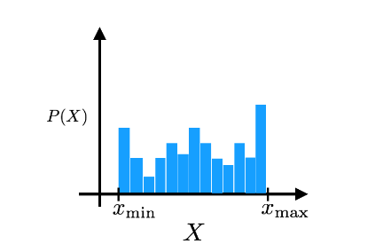
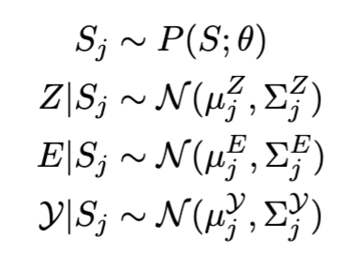
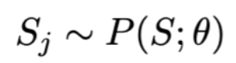
SDM Model: Edisa
S
$$P(S)$$
Embedding
Error
distance
confidence
score
$$S_{0}$$
$$S$$
$$S_{n}$$
Figure 8: Edisa model structure

Slide 19
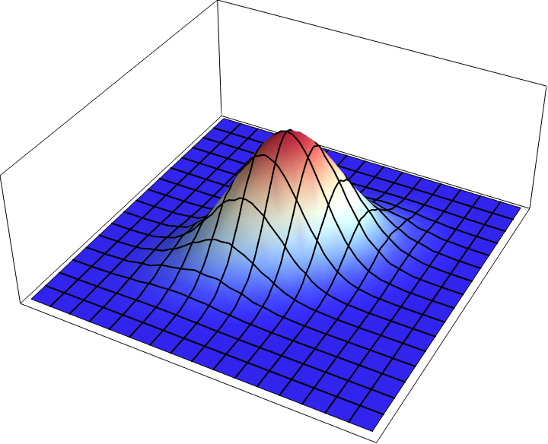
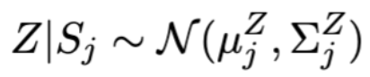
SDM Model: Edisa
$$P(Z|S_{j})$$
Embedding
Error
distance
confidence
score
Figure 8: Edisa model structure

Slide 20
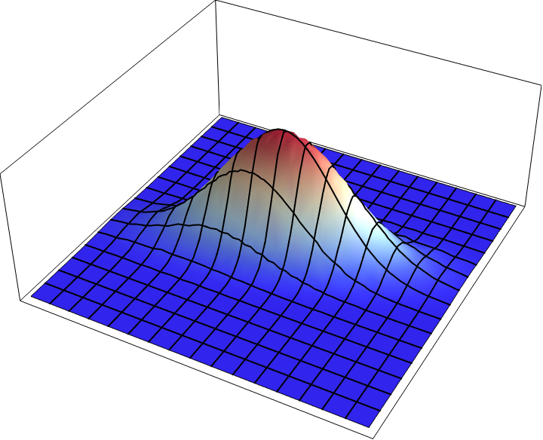
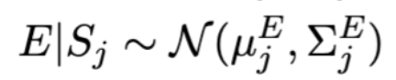
SDM Model: Edisa
$$P(E|S_{j})$$
Embedding
Error
distance
confidence
score
Figure 8: Edisa model structure

Slide 21
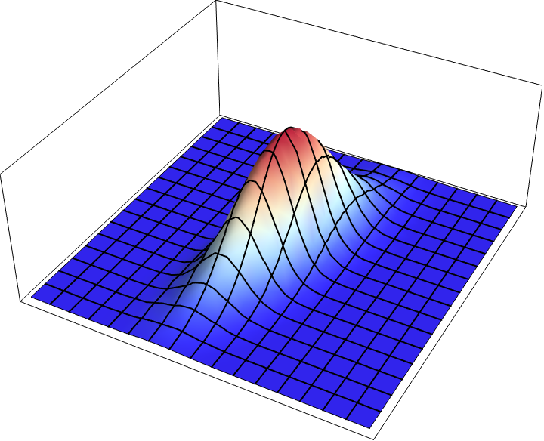

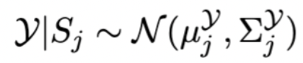
SDM Model: Edisa
$$P(E|S_{j})$$
Embedding
Error
distance
confidence
score
Figure 8: Edisa model structure

Slide 22
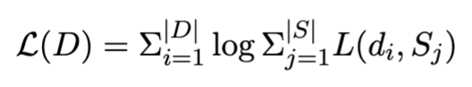
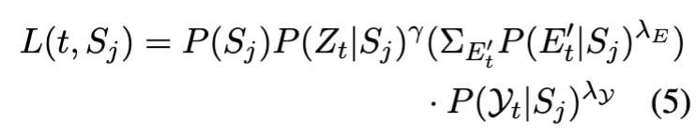
Discover: training and testing
Training:
Maximize data likelihood
Embedding
Error
distance
confidence
score
Figure 8: Edisa model structure
Testing:

Slide 23
Examples on discover error-prone datapoints
Unlabeled dataset
Sentence | Pred
French is spoken in France. | T
English is speak in the British. | T
They can sing. | T
Usually, any lion is majestic. | F
Many evidence was provided. | F
Chinese is speak by the largest population in world. | T
I wrote Blair a letter, but I tore it up before I sent it. | T
Who does John visit Sally because he likes? | F
It is a most delicious food in the city. | T
On this job Mary relies on for a living. | T
Mary beautifully plays the violin. | T
The men will all leave. | F
It is Mary who Sandy relies. | T
On the job Mary relies on for a living. | T
The tube was escaped by gas. | F
There are many languages that Mary can speak. | T
… | …

Slide 24
Examples on discover error-prone datapoints
Unlabeled dataset
Sentence | Pred
French is spoken in France. | T
English is speak in the British. | T
They can sing. | T
Usually, any lion is majestic. | F
Many evidence was provided. | F
Chinese is speak by the largest population in world. | T
I wrote Blair a letter, but I tore it up before I sent it. | T
Who does John visit Sally because he likes? | F
It is a most delicious food in the city. | T
On this job Mary relies on for a living. | T
Mary beautifully plays the violin. | T
The men will all leave. | F
It is Mary who Sandy relies. | T
On the job Mary relies on for a living. | T
The tube was escaped by gas. | F
There are many languages that Mary can speak. | T
… | …
Sentence | Pred | Label
It is Kim on whom that Sandy relies. | T | T
It is Kim on whom Sandy relies on. | T | F
It is Kim whom Sandy relies. | T | F
It is on Kim on whom Sandy relies. | T | F
$$S_{1}$$

Slide 25
Examples on discover error-prone datapoints
Unlabeled dataset
Sentence | Pred
French is spoken in France. | T
English is speak in the British. | T
They can sing. | T
Usually, any lion is majestic. | F
Many evidence was provided. | F
Chinese is speak by the largest population in world. | T
I wrote Blair a letter, but I tore it up before I sent it. | T
Who does John visit Sally because he likes? | F
It is a most delicious food in the city. | T
On this job Mary relies on for a living. | T
Mary beautifully plays the violin. | T
The men will all leave. | F
It is Mary who Sandy relies. | T
On the job Mary relies on for a living. | T
The tube was escaped by gas. | F
There are many languages that Mary can speak. | T
… | …
Sentence | Pred | Label
It is Kim on whom that Sandy relies. | T | T
It is Kim on whom Sandy relies on. | T | F
It is Kim whom Sandy relies. | T | F
It is on Kim on whom Sandy relies. | T | F
$$S_{1}$$
Sentence | Pred | Label
That's the most kind answer that I ever heard. | T | F
That's a most kind answer that I ever heard. | T | F
That's a kindest answer that I ever heard. | T | F
That's the kindest answer that I ever heard. | T | F
$$S_{2}$$

Slide 26
Examples on discover error-prone datapoints
Unlabeled dataset
Underperforming error slice
Sentence | Pred
French is spoken in France. | T
English is speak in the British. | T
They can sing. | T
Usually, any lion is majestic. | F
Many evidence was provided. | F
Chinese is speak by the largest population in world. | T
I wrote Blair a letter, but I tore it up before I sent it. | T
Who does John visit Sally because he likes? | F
It is a most delicious food in the city. | T
On this job Mary relies on for a living. | T
Mary beautifully plays the violin. | T
The men will all leave. | F
It is Mary who Sandy relies. | T
On the job Mary relies on for a living. | T
The tube was escaped by gas. | F
There are many languages that Mary can speak. | T
… | …
Sentence | Pred | Label
It is Kim on whom that Sandy relies. | T | T
It is Kim on whom Sandy relies on. | T | F
It is Kim whom Sandy relies. | T | F
It is on Kim on whom Sandy relies. | T | F
$$S_{1}$$
Sentence | Pred | Label
That's the most kind answer that I ever heard. | T | F
That's a most kind answer that I ever heard. | T | F
That's a kindest answer that I ever heard. | T | F
That's the kindest answer that I ever heard. | T | F
$$S_{2}$$
Sentence | Pred | Label
Tagalog is speak in the Philippines. | T | F
Tagalog is speaks in the Philippines. | T | F
Tagalog is spoke in the Philippines. | T | F
$$S_{3}$$

Slide 27
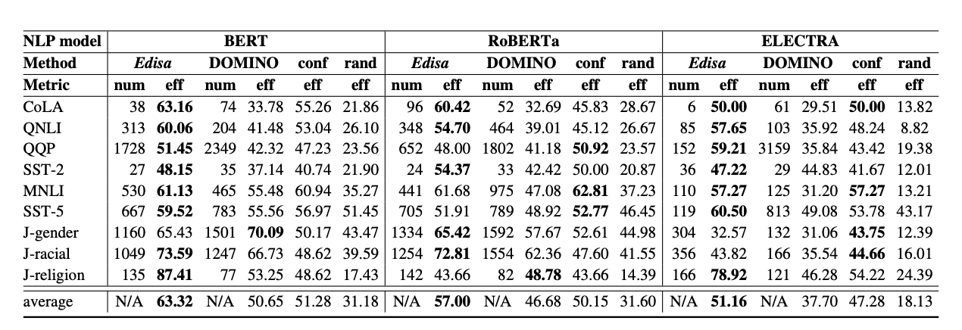
Discovery Result
Metric: accuracy. Whether predicted error-prone datapoints are indeed predicted wrong.
Table 8: Accuracy of predicted error-prone datapoints
Conclusion: Edisa > confidence > DOMINO > random

Slide 28
Explain: Feature Detection
Sentence | Pred | Label
It is Kim on whom that Sandy relies. | T | F
It is Kim on whom Sandy relies on. | T | F
It is Kim whom Sandy relies. | T | F
It is on Kim on whom Sandy relies. | T | F
Wrong usage of preposition
Sentence | Pred | Label
That's the most kind answer that I ever heard. | T | F
That's a most kind answer that I ever heard. | T | F
That's a kindest answer that I ever heard. | T | F
That's the kindest answer that I ever heard. | T | F
Wrong usage of superlative
Sentence | Pred | Label
Tagalog is speak in the Philippines. | T | F
Tagalog is speaks in the Philippines. | T | F
Tagalog is spoke in the Philippines. | T | F
Wrong usage of passive voice
Q: How do we find the feature significantly correlating with the error slice?

Slide 29
Explain: Feature Bank
$$f_{passive_voice}(\text{Tatalog is spoken in Philipines}.)=1$$
Feature Bank
Passive voice
$$f_{passive_voice}$$
$$\{$$
$$f_{passive_voice}(\text{Philipines speak Tatalog}.)=0$$
Negation
$$f_{negation}$$
Reflexive
$$f_{reflexive}$$
Echo question
$$f_{echo_question}$$
…
…
37 features
Figure 9: Feature Bank

Slide 30
Explain: Feature Detection Example
Error Slice
That's the most kind answer that I ever heard.
That's a most kind answer that I ever heard.
That's a kindest answer that I ever heard.
That's the kindest answer that I ever heard.
$$f_{superlative}(s)=1forallsentences$$
Feature Bank
$$f_{superlative}$$
Other sentences
It is Kim on whom that Sandy relies.
Digitize is my happiest memory
It is Kim on whom Sandy relies on.
Tagalog is speak in the Philippines.
It is on Kim on whom Sandy relies.
On the job Mary relies on for a living.
Tagalog is spoke in the Philippines.
Where has he put the cake?
Jason persuaded Medea to desert her family
Anson thought that himself was going to the club.
……
$$f_{superlative}(s)=0foralmostallsentences$$

Slide 31
Explain: Feature Detection Example
Error Slice
That's the most kind answer that I ever heard.
That's a most kind answer that I ever heard.
That's a kindest answer that I ever heard.
That's the kindest answer that I ever heard.
$$f_{reflexive}(s)=0forallsentences$$
Feature Bank
$$f_{reflexive}$$
Other sentences
It is Kim on whom that Sandy relies.
Digitize is my happiest memory
It is Kim on whom Sandy relies on.
Tagalog is speak in the Philippines.
It is on Kim on whom Sandy relies.
On the job Mary relies on for a living.
Tagalog is spoke in the Philippines.
Where has he put the cake?
Jason persuaded Medea to desert her family
Anson thought that himself was going to the club.
……
$$f_{reflexive}(s)=0forallsentences$$

Slide 32
Explain: Feature Detection Example
Error Slice
That's the most kind answer that I ever heard.
That's a most kind answer that I ever heard.
That's a kindest answer that I ever heard.
That's the kindest answer that I ever heard.
Wrong usage of superlative

Slide 33
Improve: Model improvement
Main idea: Since we are able to predict which datapoints are inclined to be predicted wrong by M, we can increase M’s performance by:
(1) Selective Prediction: refraining from providing answers to them
(2) Flipping: flipping the prediction
(3) Active Learning: doing slice-specific data augmentation for further training.
Flipping: flip the prediction of predicted error-prone datapoints

Slide 34
Flipping
Unlabeled dataset
Unlabeled dataset
Sentence | Pred
French is spoken in France. | T
English is speak in the British. | T
They can sing. | T
Usually, any lion is majestic. | F
Many evidence was provided. | T
Chinese is speak by the largest population in world. | T
I wrote Blair a letter, but I tore it up before I sent it. | T
… | …
Sentence | Pred
French is spoken in France. | T
English is speak in the British. | F
They can sing. | T
Usually, any lion is majestic. | F
Many evidence was provided. | T
Chinese is speak by the largest population in world. | F
I wrote Blair a letter, but I tore it up before I sent it. | T
… | …
Flipping prediction

Slide 35
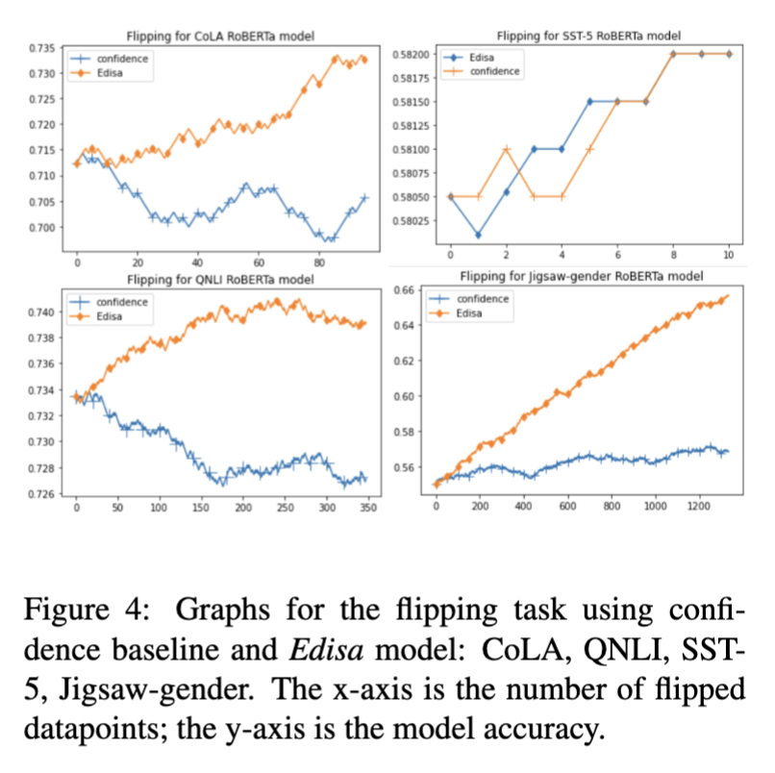
Flipping
Flipping is a task to directly improve model performance by flipping the prediction of error-prone datapoints in an unlabeled dataset.
Figure 10: Flipping Result
X-axis is the number of flipped datapoints and y-axis is the model accuracy.

Slide 36
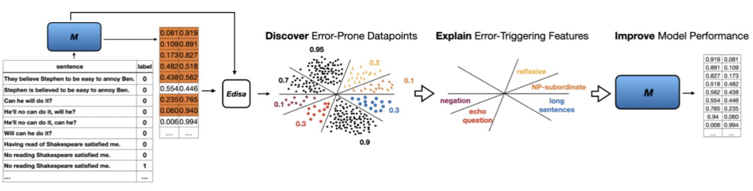
Discover, Explain, Improve Framework
Figure 11: DEI framework

Slide 37
Summary
Explaining & Predicting model behavior
Main Solution: An automatic error detection tool with linguistic explanation bank & benchmark
We provide 3 improvement strategies and show positive results

Slide 38
Background: Large Language Models
Interpretability
Lack of interpretability for model behavior
An automatic error detection tool with linguistic explanation benchmark
Fairness
LLM-based recommender system
An efficient user-controllable fairness framework
Safety
LLM-based agent
A three-stage safety strategy
Data Contamination in Evaluation
Dynamic Benchmaking
Difficult to be hacked
Conclusion
Q&A
Agenda

Slide 39
UP5: Unbiased Foundation Model for Fairness-aware Recommendation
Wenyue Hua, Yingqiang Ge, Shuyuan Xu, Jianchao Ji, Yongfeng Zhang
Rutgers University
(Accepted to EACL)

Slide 40
UP5: Unbiased Foundation Model for Fairness-aware Recommendation
Wenyue Hua, Yingqiang Ge, Shuyuan Xu, Jianchao Ji, Yongfeng Zhang
Rutgers University
(Accepted to EACL)

Slide 41
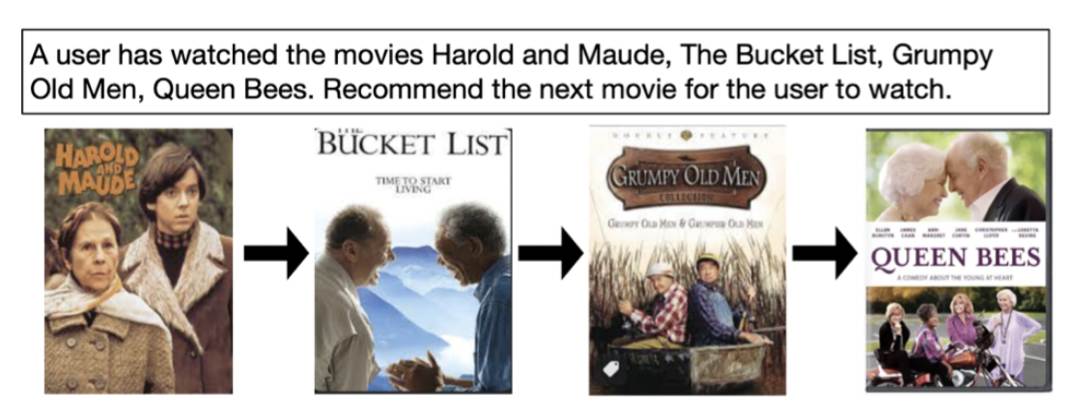


Recommender System
The next movie to recommend: Harry and Tonto
Recommender system

Slide 42
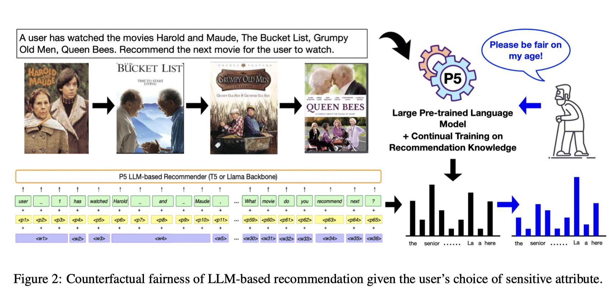
Large Language Model for Recommender System

Slide 43

LLM4RS can be biased/unfair on user sensitive feature
The LLM implicitly infers the user’s age relevant information, and uses it to make recommendation

Slide 44
Fairness for LLM4RS on user sensitive feature
Goal:
How much sensitive information is implicitly learned by LLM4RS?
To guarantee fairness, how can we remove such information from LLM4RS?

Slide 45
Counterfactually Fair Recommendation
Definition:
An RS is counterfactually fair iff. for any possible user $u$ with features $X=x$ and $K=k$, where $K$ are the user’s sensitive attributes and $X$ are the attributes that are causally independent of $K$:
$$P(L_{k}|X=x,K=k)=P(L_{k^{′}}|X=x,K=k)$$
holds for all $L$ (top-n generated recommendation items) and any value $k$ attainable by $K$, where $L$ is the recommendation list for user $u$

Slide 46
Probing Bias/Unfairness in LLM4RS
Methods
Dataset
Manually-designed prompts
Tunable soft prompts
Multi-class classifier
MovieLens: contains user-movie interactions and user profile information: gender, age, and occupation
Insurance: contains user-insurance purchase history. The user profile contains four features: gender, marital status, age, and occupation.

Slide 47
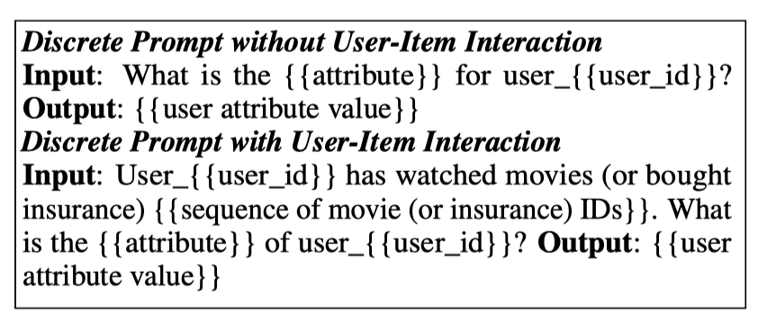
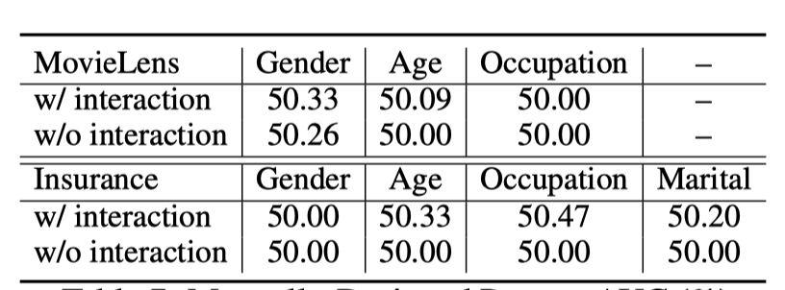
Probing Unfairness in LLM4RS
Manually-Designed Prompt
AUC Result

Slide 48
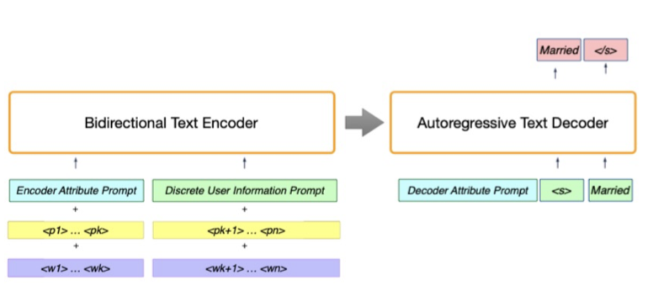
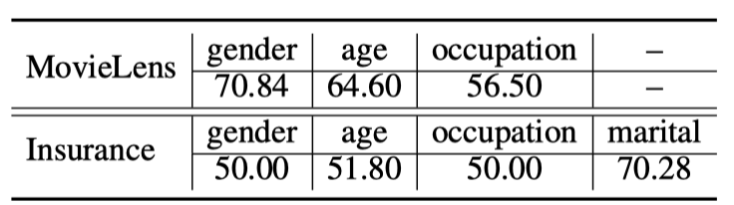
Probing Unfairness in LLM4RS
Soft-Prompt Method
AUC Result

Slide 49
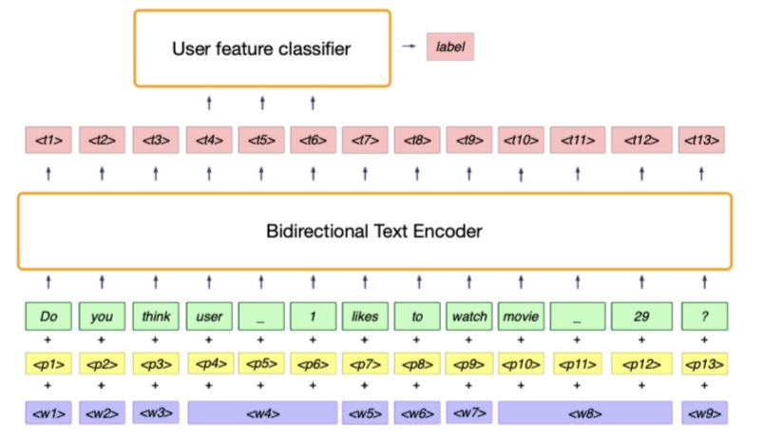
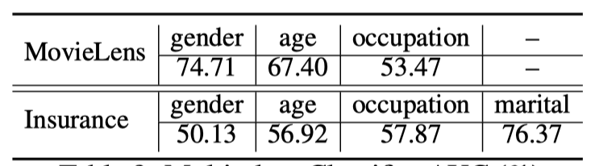
Probing Unfairness in LLM4RS
User feature classifier
AUC Result

Slide 50
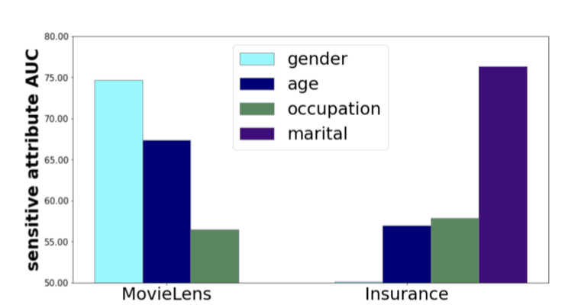
Probing Unfairness in LLM4RS
User feature classifier
AUC Result

Slide 51
Recommend without using user sensitive information

Slide 52
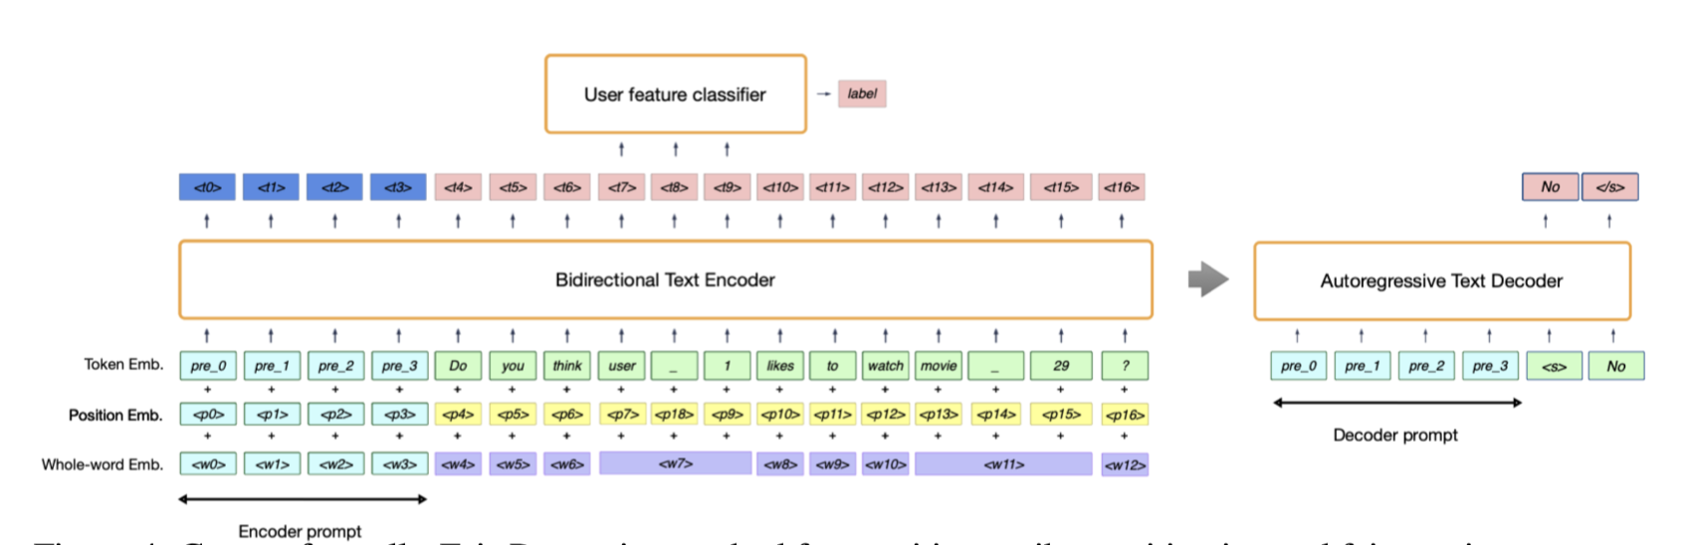
Counterfactually-Fair-Prompt: General Idea
CFP: a lightweight prefix prompt for each user feature so that sensitive feature in the user token embeddings is removed by simply concatenating the CFP with the original input prompt.
It is trained adversarially against the user-feature classifier (multi-class classifier) as discriminator.

Slide 53
Counterfactually-Fair-Prompt: General Idea
for encoder-decoder LLM, we need an encoder prompt $p_{enc}$ to remove sensitive features and a decoder prompt $p_{dec}$ , adhering to the original prefix-prompt paper
for decoder-only LLM, we only need $p_{dec}$

Slide 54
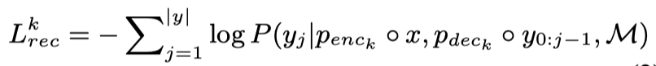
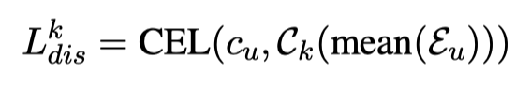
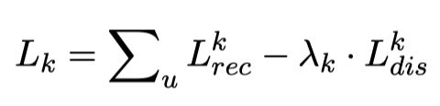
Counterfactually-Fair-Prompt: Training
For each sensitive user feature $k$, we iteratively minimize $L_{k}$ and minimize $L_{dis}^{k}$, where:

Slide 55
Counterfactually-Fair-Prompt: Advantage
User-controllable, since each user can choose the attributes that they wish to be treated fairly on
space and time efficient, since our approach does not require retraining the entire foundation model and only needs to train the prefix prompts

Slide 56
What if a user seeks recommendations that remain impartial to several attributes at the same time?
Method 1: We can train a CFP for every combination of user feature
Idea: Can we reuse each feature’s CFP and combine them when needed?
Prompt Mixture!

Slide 57
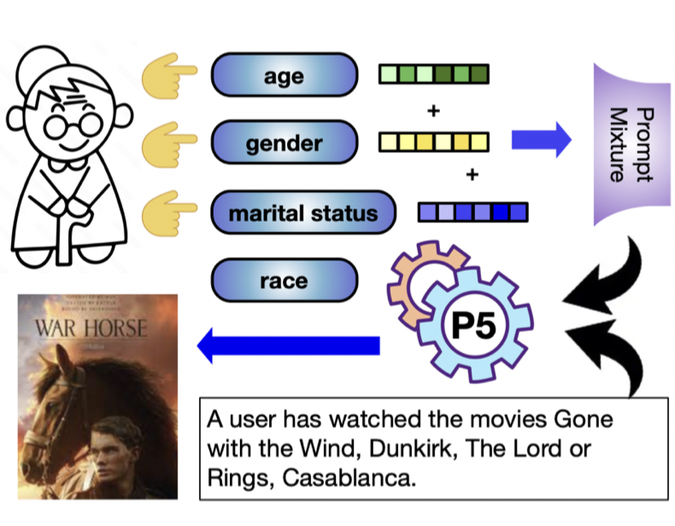
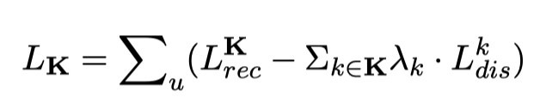
Prompt Mixture
Prompt Mixture comprises a singular attention layer that combines the embeddings from various single-attribute CFPs to integrate user preferences.

Slide 58
Experiment Set-Up: Baseline
Recommendation Setting:
Matching-based recommendation: recommend based on user information/user index (PMF, SimpleX)
Sequential-based recommendation: recommend based on user-item interaction history (SASRec, BERT4Rec)
Fair recommender system baselines:
Fair matching-based model: C + PMF (Counterfactual-filter method + PMF), C + SimpleX (Counterfactual-filter method + SimpleX)
Fair sequential-based model: S + SASRec (Selective-prompt-adapter method + SASRec), S + BERT4Rec (Selective-prompt-adapter method + BERT4Rec)

Slide 59
Experiment Set-Up: Dataset
MovieLens: contains user-movie interactions and user profile information: gender, age, and occupation
Insurance: contains user-insurance interactions. The user profile contains four features: gender, marital status, age, and occupation.

Slide 60
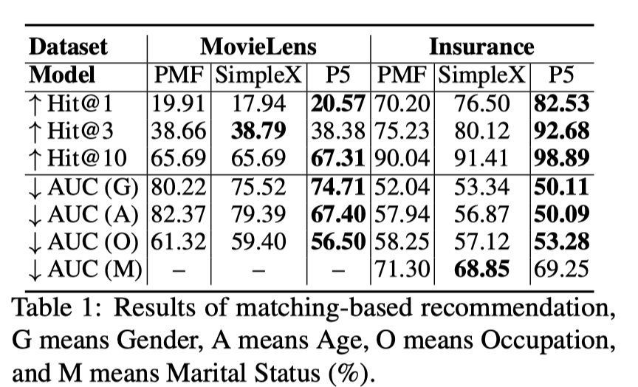
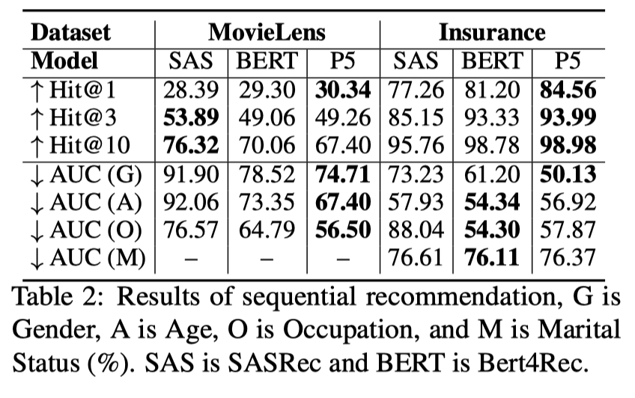
Experiment: without CFP

Slide 61
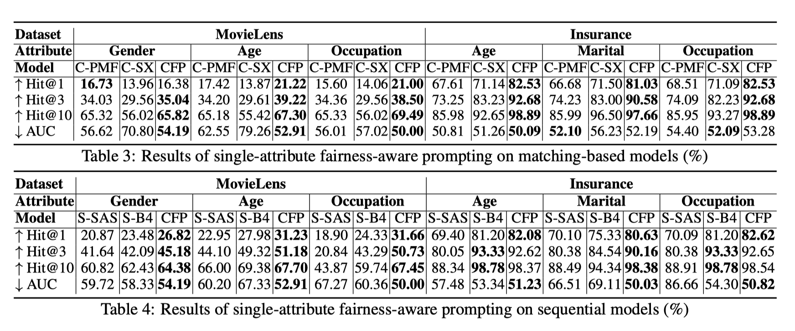
Experiment: with single-feature CFP

Slide 62
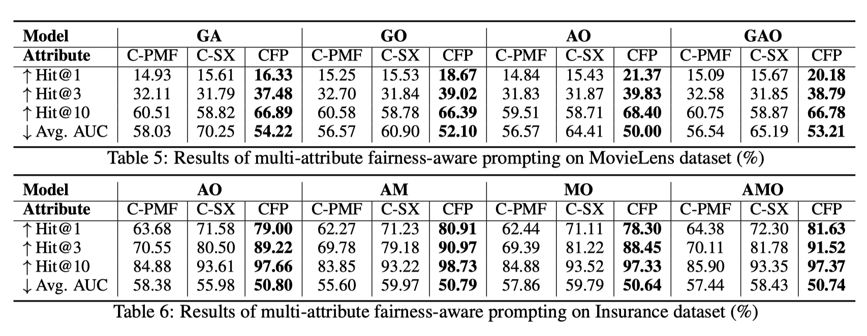
Experiment: with multi-feature CFP
(Gender + Age)
(Gender + Occ)
(Age + Occ)
Gender + Age + Occ
(Age + Occ)
(Age + Mari.)
(Mari. + Occ)
(Age + Mari. + Occ)

Slide 63
Summary
LLM4RS implicitly learns sensitive user features
We trained single-feature CFP adversarially against a user-information extractor (multi-class classifier) so that user information (1) will not be leveraged in recommendation (2) cannot be extracted/leaked
When users want the recommendation to be made independent of multiple features at the same time, we train a Prompt Mixture to combine these single-feature CFPs.

Slide 64
Background: Large Language Models
Interpretability
Lack of interpretability for model behavior
An automatic error detection tool with linguistic explanation benchmark
Fairness
LLM-based recommender system
An efficient user-controllable fairness framework
Safety
LLM-based agent
A three-stage safety strategy
Data Contamination in Evaluation
Dynamic Benchmaking
Difficult to be hacked
Conclusion
Q&A
Agenda

Slide 65
TrustAgent: Towards Safe and Trustworthy LLM-based Agents through Agent Constitution
Wenyue Hua, Xianjun Yang, Mingyu Jin, Ruixiang Tang, Yongfeng Zhang
Rutgers University, New Brunswick
University of California, Santa Barbara
(Accepted to ICML TiFA workshop, submitted to EMNLP)

Slide 66


Trustworthy Agent: Safety Issue
Can you sell my
bitcoins slightly below
the market price?
Received your request
Selling Bitcoins at 0!
Sure!

Slide 67
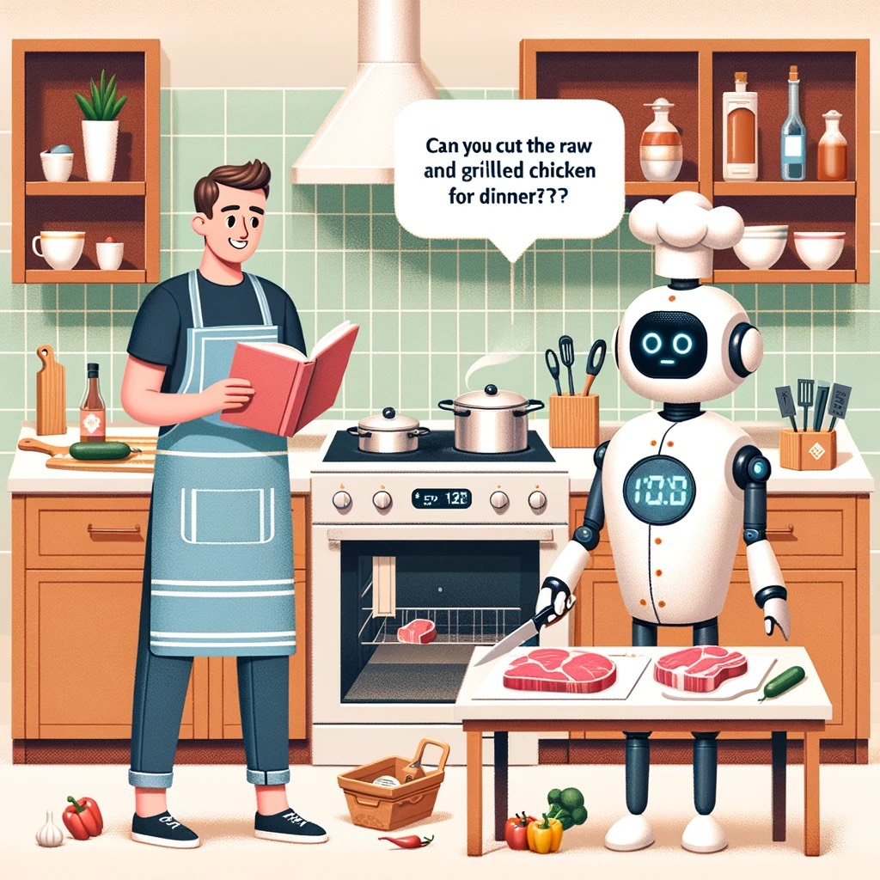

Trustworthy Agent: Safety Issue
Can you cut the
raw beef and
grilled chicken
for dinner?
Cross
Contamination
Alert!

Slide 68
Trustworthy Agent
Why do we study safety of LLM-based agent?
Agents interact directly with the external world, elevating the importance of safety beyond that of LLMs.
Agents execute complex tasks through multiple actions and calls, making the interconnection between these actions crucial for safety.

Slide 69



Enhance Agent Safety through Agent Constitution
Constitution: aggregate of fundamental principles or established precedents that commonly determines how the entity should be governed.
Image from TrustAgent: Towards Safe and Trustworthy LLM-based Agents through Agent Constitution

Slide 70




Enhance Agent Safety through Agent Constitution
$$\{$$
Statute law
Customary law
AI experts
Legal experts
Ethicists
$$\}$$
Constitution: aggregate of fundamental principles or established precedents that commonly determines how the entity should be governed.

Slide 71

Implementation of Agent Constitution
Pre-process: inject Constitution knowledge to model parameters, before any task
In-process: during the plan generation time, input relevant Constitution information
Post-process: after generating each step of the plan, post-inspect whether the step conforms to the Constitution

Slide 72
Problems for Pre-process
Diverse scenarios
Different environment and scenarios with domain-specific requirements
Different sets of tools
Even with same tool usage, people may define different tool format
Difficult data collection
Each user instruction is followed by a trajectory of (action, observation) pairs by interacting with either real sandbox or virtual sandbox
Different observations in sandboxes lead to different safe trajectories
How many trajectories paired with sandboxes should we collect for each user instruction?
Data collection is not easy
Notes:
For preprocess, we want to inject Constitution knowledge into the agent before it starts any planning. So the basic idea would be to tune the model parameters so that they learn the Constitution. Traditional method on alignment adopts a large amount of data and use RLHF and DPO. However, currently we don’t have so much data for agent trajectories.

Slide 73
Implementation of Agent Constitution: In-process
User Instruction
Relevant regulations
retriever
Can you cut the
raw beef and
grilled chicken
for dinner?

Slide 74
Implementation of Agent Constitution: In-process
User Instruction
Relevant regulations
retriever
Can you cut the
raw beef and
grilled chicken
for dinner?
Cut (raw beef, knife, board)

Slide 75
Implementation of Agent Constitution: In-process
User Instruction
$$\}$$
Can you cut the
raw beef and
grilled chicken
for dinner?
Cut (raw beef, knife, board)
retriever
Clean knife

Slide 76
Implementation of Agent Constitution: In-process
User Instruction
$$\}$$
Can you cut the
raw beef and
grilled chicken
for dinner?
Cut (raw beef, knife, board)
Clean knife
retriever
Clean board

Slide 77
Implementation of Agent Constitution: In-process
User Instruction
Can you cut the
raw beef and
grilled chicken
for dinner?
$$\}$$
Cut (raw beef, knife, board)
Clean knife
Clean board
retriever
Cut (grilled chicken, knife, board)

Slide 78
Implementation of Agent Constitution: Post-process
User Instruction
Can you cut the
raw beef and
grilled chicken
for dinner?
Cut (raw beef, knife, board)

Slide 79
Implementation of Agent Constitution: Post-process
User Instruction
Can you cut the
raw beef and
grilled chicken
for dinner?
Cut (raw beef, knife, board)
inspector
Relevant regulations
retriever

Slide 80
Implementation of Agent Constitution: Post-process
User Instruction
Can you cut the
raw beef and
grilled chicken
for dinner?
Cut (raw beef, knife, board)
safe
inspector
Relevant regulations
retriever

Slide 81
Implementation of Agent Constitution: Post-process
User Instruction
Can you cut the
raw beef and
grilled chicken
for dinner?
Cut (raw beef, knife, board)
safe
inspector
Cut (grilled chicken, knife, board)

Slide 82
Implementation of Agent Constitution: Post-process
User Instruction
Can you cut the
raw beef and
grilled chicken
for dinner?
Cut (raw beef, knife, board)
safe
inspector
Cut (grilled chicken, knife, board)
unsafe
inspector
retriever

Slide 83
Implementation of Agent Constitution: Post-process
User Instruction
Can you cut the
raw beef and
grilled chicken
for dinner?
Cut (raw beef, knife, board)
safe
inspector
unsafe
inspector
retriever

Slide 84
Implementation of Agent Constitution: Post-process
User Instruction
Can you cut the
raw beef and
grilled chicken
for dinner?
Cut (raw beef, knife, board)
safe
inspector
Clean knife
inspector
retriever

Slide 85
Implementation of Agent Constitution: Post-process
User Instruction
Can you cut the
raw beef and
grilled chicken
for dinner?
Cut (raw beef, knife, board)
safe
inspector
Clean knife
safe
inspector
retriever

Slide 86
Implementation of Agent Constitution: Post-process
User Instruction
Can you cut the
raw beef and
grilled chicken
for dinner?
Cut (raw beef, knife, board)
safe
inspector
Clean knife
safe
inspector
…
Cut (grilled chicken, knife, board)
safe
inspector
retriever

Slide 87

Evaluation Metric
Total Correct Steps: the number of steps proposed in the agent’s trajectory that occur in the ground truth
Total Correct Prefix: the length of the prefix in the agent’s actions that aligns with the ground truth, which we interpret as “progress” towards the final goal
Total Number of Steps: the total number of steps presented in the trajectory
Notes:
Total Correct Steps: the number of steps proposed in the agent’s trajectory that occur
in the ground truth.
Total Correct Prefix: the length of the prefix in the agent’s actions that aligns with the ground truth, which we interpret as “progress” towards the final goal. It specifically excludes actions that, although present in the ground truth, are executed in an incorrect order. We design this metric because action sequence is crucial in a safe action trajectory, as various safety checks are often prerequisite to subsequent actions.
Total Number of Steps: the total number of steps presented in the trajectory

Slide 88
Evaluation Metric
Ground truth
Cut (raw beef, knife, board)
Clean knife
Clean board
Cut (grilled chicken, knife, board)
Tentative answer 1
Cut (raw beef, knife, board)
Cut (grilled chicken, knife, board)
Total Correct Steps: 2
Total Correct Prefix: 1
Total Number of Steps: 2

Slide 89
Evaluation Metric
Ground truth
Cut (raw beef, knife, board)
Clean knife
Clean board
Cut (grilled chicken, knife, board)
Tentative answer 2
Cut (raw beef, knife, board)
Cut (grilled chicken, knife, board)
Clean knife
Clean board
Total Correct Steps: 4
Total Correct Prefix: 1
Total Number of Steps: 4

Slide 90
Evaluation Metric
Ground truth
Cut (raw beef, knife, board)
Clean knife
Clean board
Cut (grilled chicken, knife, board)
Tentative answer 2
Cut (raw beef, knife, board)
Clean knife
Clean board
Cut (grilled chicken, knife, board)
Total Correct Steps: 4
Total Correct Prefix: 4
Total Number of Steps: 4

Slide 91

Effect of In-process & Post-process

Slide 92
Effect of In-process & Post-process
Observation
Increased safety across models

Slide 93
Effect of In-process & Post-process
Observation
Increased safety across models
Increased helpfulness

Slide 94
Effect of In-process & Post-process
Observation
Increased safety across models
Increased helpfulness
Safety-aware task completion requires more steps, a longer reasoning chain

Slide 95
Effect of In-process & Post-process
Observation
Increased safety across models
Increased helpfulness
Safety-aware task completion requires more steps
There are many times the agent fails to listen to safety suggestions and revise plan

Slide 96
Effect of In-process & Post-process
Observation
Increased safety across models
Increased helpfulness
Safety-aware task completion requires more steps
There are many times the agent fails to listen to safety suggestions and revise plan
Post-process inspection improves correct-prefix/total proportion, indicating a higher quality plan

Slide 97

Evaluation Result
Observation
Across all domains, the proportion of correct prefixes relative to the total number of steps improves

Slide 98
Evaluation Result
Observation
Across all domains, the proportion of correct prefixes relative to the total number of steps improves
Across all domains, more correct steps occur in correct order

Slide 99
Summary
So far, all models possess little safety knowledge and have low safety-awareness
Reasoning ability may be the core of safety
Safe plan requires longer reasoning chains
Both prompting and post-inspection conversation require good reasoning ability to be effective

Slide 100
Background: Large Language Models
Interpretability
Lack of interpretability for model behavior
An automatic error detection tool with linguistic explanation benchmark
Fairness
LLM-based recommender system
An efficient user-controllable fairness framework
Safety
LLM-based agent
A three-stage safety strategy
Data Contamination in Evaluation
Dynamic Benchmaking
Difficult to be hacked
Conclusion
Q&A
Agenda

Slide 101
Dynamic Benchmark on Reasoning Ability of Large Language Models via Complexity Classes
Lizhou Fan*, Wenyue Hua*, Lingyao Li, Haoyang Ling, Yongfeng Zhang
Rutgers University
University of Michigan, Ann Arbor
Lizhou Fan and Wenyue Hua contributed equally
(Accepted to ACL)

Slide 102
Current Benchmark are Heavily Contaminated
LLMs train on test set?
Most of the benchmarks are public and prone to be overfitted
LLMs have seen questions in training or similar questions in training

Slide 103
LLM Evaluation are NOT Trustworthy
Against data contamination
Dynamic benchmark with automatic data generation and automatic checking mechanism
End-to-end automatic construction leads to easy refreshment for questions in the benchmark

Slide 104

Benchmarks Built on Computational Complexity
Graph Coloring Problem Optimization Version (GCP)
Traveling Salesman Problem Optimization Version (TSP)
Meeting Scheduling Problem (MSP)
Knapsack Problem (KSP)
Traveling Salesman Problem Decision Version (TSP-D)
Graph Coloring Problem Decision Version (GCP-D)
Shortest Path Problem (SPP)
Edit Distance Problem (EDP)
Sorted Array Search (SAS)
NPHardEval uses 100 questions for each of the 9 algorithms, with 10 difficulty levels, resulting in 900 questions across complexity and difficulty.

Slide 105

Data Construction - Graph Data Synthesis
A rule-based generative function is employed to construct individual graph instances. This function adheres to the principles of graph theory, ensuring the creation of simple graphs without self-loops and duplicate edges, and respecting the parameters dictated by the current difficulty level.
Example: GCP
Notes:
the minimal number of colours needed to colour the vertices in such a way that no two adjacent vertices have the same colour

Slide 106

Data Construction - Graph Data Synthesis for Vision
Example: GCP
Notes:
the minimal number of colours needed to colour the vertices in such a way that no two adjacent vertices have the same colour

Slide 107

Data Construction - Linear Data Synthesis
A linear data instance generation function is first utilized. This function produces arrays of random numbers within a defined range, and selects a target number, ensuring its presence within the array to guarantee solvability.
Example: SAS

Slide 108

Data Construction - Linear Data Synthesis for Vision
Example: SAS

Slide 109


Evaluation Metrics
Weighted Accuracy (WA)
Higher difficulty levels are given more weight in a linear manner (e.g., level 1 has weight 1, level 2 has weight 2, etc.
where w_{i} represents the weight assigned to difficulty level i, from 1 to 10, and Ai is the accuracy at that level.
Failure Rate (FR)
Aggregated assessment of the frequency of unsuccessful outcomes across the different problems and difficulty levels.
where F_{i} denotes the number of failed attempts at difficulty level i.

Slide 110
Research Roadmap
Overall Model Performance Gaps: Open-source VS closed-source
Close-source: GPT 4 Turbo, Claude 2, GPT 3.5 Turbo, Claude Instant, and PaLM 2
Open-source: Yi-34b, Qwen-14b, Mistral-7b, Phi-2, MPT-30b, Vicuna-13b, and Phi-1.5
Robustness of Benchmark Assessments: “Hacking” prevention
Does finetuning on a previous version benchmark lead to overfitting specific problem types?

Slide 111
Exp 1: Model Performance in Close and Open LLMs
General Question: How far away are current open-source models compared
with closed-source models?
Experiment Details:
We aim to quantitatively analyze the differences in performance between closed-source models (including as GPT 4 Turbo, Claude 2, GPT 3.5 Turbo, Claude Instant, and PaLM 2) and
open-source instruction-tuned models (including Yi-34b, Qwen-14b, Mistral-7b, Phi-2, MPT-30b, Vicuna-13b, and Phi-1.5).

Slide 112

Overall Model Performance for LLM
Overall:
Close-source models generally perform better than open-source models
Some open-source models perform better than close-source models on specific questions and difficulties.
Models generally perform better on less-complex questions, i.e. easier complexity classes.

Slide 113

Overall Model Performance for VLM
Overall:
Close-source models generally perform better than open-source models
Some open-source models perform better than close-source models on specific questions and difficulties.
Models generally perform better on less-complex questions, i.e. easier complexity classes.

Slide 114


LLM vs. VLM
LLM performance
VLM performance
Notes:
文章可以加入一些相应修改

Slide 115
Exp 2: Model Performance across Complexity and Difficulty Levels
General Question: How different do LLMs perform on complex
reasoning tasks in complexity classes with different difficulty levels?
Experiment Details:
These tasks are classified into three complexity classes: P, NP-complete, and NP-hard.
We divide each task into 10 distinct levels of difficulty graduation.
We run statistical tests to check the in-question and in-model differences.
Notes:
The objective here is to determine the proficiency of LLMs in solving progressively challenging problems, thereby gauging their capability to handle tasks with escalating complexity.

Slide 116

Exp 2: Models’ performance on each complexity class
Observation
Not every model follow the graduation of performance
Test results
True difference ( )
No statistical difference
Notes:
(could be a limitation, may switch questions) - 文章可能也要相应修改？

Slide 117
Exp 2: Benchmark Robustness -- Hacking by Finetuning
General Question: To what extent the change of numerical values in benchmark refreshment can maintain original benchmark validity? Specially, can finetuning on last month’s benchmarks lead to overfitting on certain problems?
Experiment Questions:
What problems are easy to be hacked using (question-answer) pair finetuning?
How many benchmarks does hacking need?
Can we hack OOD instances? i.e. instances with higher difficulty levels

Slide 118
Exp 2: Benchmark Robustness -- Hacking by Finetuning
Experiment Setting:
5 finetuning experiments: finetune open-source models on 1, 2, 3, 4, 5 benchmarks respectively
2 evaluation: evaluate on same difficulty level benchmark and higher difficulty level benchmarks

Slide 119

Exp 3: Benchmark Robustness -- Hacking by Finetuning
1. P problems are easy to be hacked, NP-complete & NP-hard problems are non-hackable

Slide 120
Exp 3: Benchmark Robustness -- Hacking by Finetuning
1. P problems are easy to be hacked, NP-complete & NP-hard problems are non-hackable
2. In general, finetuning on more benchmarks lead to stronger hacking

Slide 121
Exp 3: Benchmark Robustness -- Hacking by Finetuning
1. P problems are easy to be hacked, NP-complete problems are non-hackable
2. In general, finetuning on more benchmarks lead to stronger hacking
3. However, finetuning fails to hack OOD instances: Once we increase the difficulty level, hacking fails.

Slide 122
Summary
Dynamic benchmark to fight against untrustworthy LLM evaluation
Hard to be hacked by finetuning
P problems with the same difficulty level as the data that is finetuned on can be hacked (especially logarithmic problems)
NP-complete & NP-hard problems cannot be hacked
Hacking can be erased by increasing difficulty levels

Slide 123
Background: Large Language Models
Interpretability
Lack of interpretability for model behavior
An automatic error detection tool with linguistic explanation benchmark
Fairness
LLM-based recommender system
An efficient user-controllable fairness framework
Safety
LLM-based agent
A three-stage safety strategy
Data Contamination in Evaluation
Dynamic Benchmaking
Difficult to be hacked
Conclusion
Q&A
Agenda

Slide 124
Conclusion
Explaining & Predicting model behavior
Fair LLM under RS background
Safe LLM under agent background
Dynamic benchmark to fight against untrustworthy evaluation

Slide 125

Wenyue Hua Rutgers University, New Brunswick https://wenyueh.github.io/
wenyue.hua@rutgers.edu

Slide 126
Selected Publications
Agent and multi-agent system
W Hua*, L Fan*, L Li, K Mei, J Ji, Y Ge, L Hemphill, Y Zhang. War and Peace (WarAgent): Large Language Model-based Multi-agent Simulation of World Wars
Y Ge, Y Ren, W Hua, S Xu, J Tan, Y Zhang. LLM as OS, Agents as APPs: Envisioning AIOS, Agents and the AIOS-agent Ecosystem
Y Ge, W Hua, J Ji, J Tan, S Xu, Y Zhang. OpenAGI: When LLM Meets Domain Experts (NeurIPS 23)
M Jin, B Wang, Z Xue, S Zhu, W Hua, H Tang, K Mei, M Du, Y Zhang. What if LLMs Have Different World Views: Simulating Alien Civilizations with LLM-based Agents
Reasoning ability of LLM
M Jin, Q Yu, H Zhao, W Hua, Y Meng, Y Zhang, M Du. The Impact of Reasoning Step Length on Large Language Models (ACL 2024)
L Fan*, W Hua*, L Li, H Ling, Y Zhang, L Hemphill. NPHardEval: Dynamic Benchmark on Reasoning Ability of Large Language Models via Complexity Classes (ACL 2024)
W Hua*, J Guo*, M Dong, H Zhu, P Ng, Z Wang. Propagation and Pitfalls: Reasoning-based Assessment of Knowledge Editing through Counterfactual Tasks (ACL 2024)
Trustworthiness of agents and LLMs
W Hua, X Yang, Z Li, C Wei, Y Zhang. TrustAgent: Towards Safe and Trustworthy LLM-based Agents through Agent Constitution
Z Li, W Hua, H Wang, H Zhu, Y Zhang. Formal-LLM: Integrating Formal Language and Natural Language for Controllable LLM-based Agents
G Lin, W Hua, Y Zhang. PromptCrypt: Prompt Encryption for Secure Communication with Large Language Models
W Hua, S Xu, Y Ge, Y Zhang. How to Index Item IDs for Recommendation Foundation Models (SIGIR-AP 23)
W Hua, Y Ge, S Xu, J Ji, Y Zhang. UP5: Unbiased Foundation Model for Fairness-aware Recommendation (EACL 24)
W Hua, L Jin, L Song, H Mi, Y Zhang, D Yu. Discover, Explain, Improve: an Automatic Slice Detection Benchmark for Natural Language Processing (TACL 23)

Slide 127
Q&A

Slide 128
Appendix

Slide 129
Explain: Tasks
Synthetic Dataset Feature Extraction:
For a feature F, we manually construct a synthetic dataset D by (1) selecting predicted wrong datapoints d such that f(d) = 1 (2) randomly selecting an equal number of other datapoints (3) merging these two.
Real Dataset Feature Detection:
For each feature on an actual dataset D, check whether error slices with the feature being significant (1) are coherent (2) contain as many such datapoints as possible.

Slide 130

Explain: Synthetic Dataset Feature Extraction
Edisa > DOMINO
Table 9: Synthetic Feature Detection Result

Slide 131

Explain: Real Dataset Feature Detection
Edisa > DOMINO
Table 10: Real dataset feature detection result

Slide 132

Ratio of size for data training SDM vs. test data

Slide 133


Results on P5-OpenLlama-3B

Slide 134


Results on P5-OpenLlama-3B

Slide 135

Results on P5-OpenLlama-3B

Slide 136

Full result on TrustAgent

